Slide 1


Transcriptomics
Paweł Dąbrowski-Tumański
MiNI Lecture, Fall 2025

Slide 2
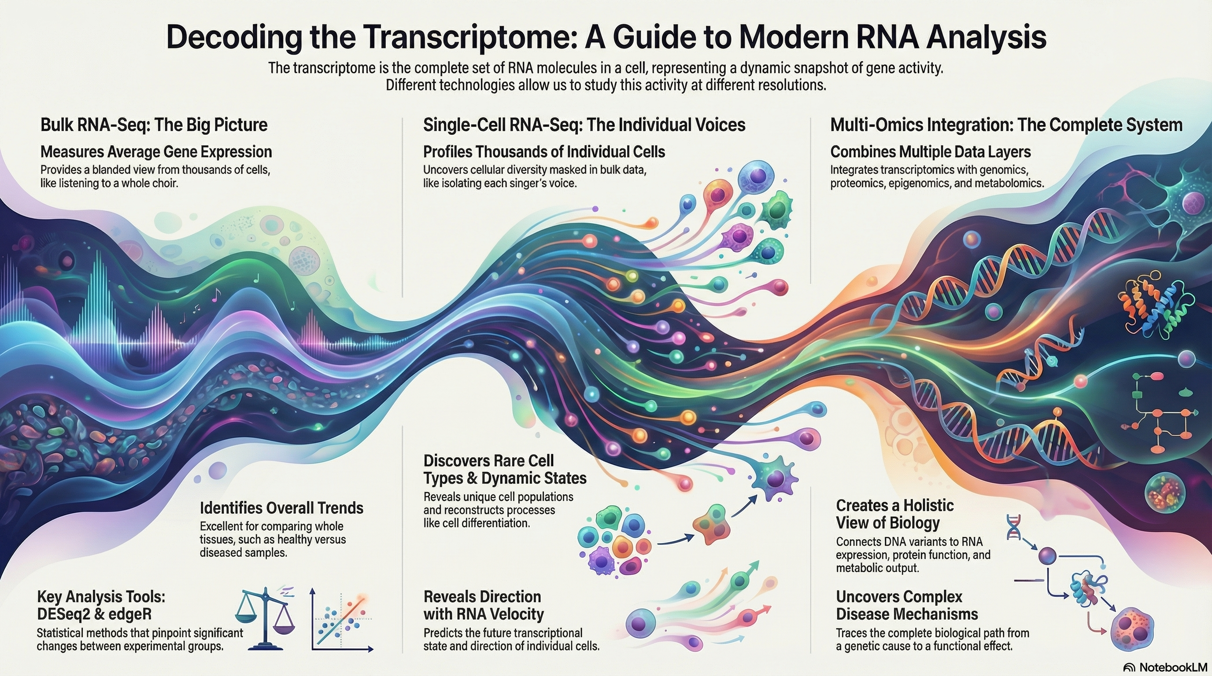

WHAT IS TRANSCRIPTOMICS?

Slide 3







WHAT IS TRANSCRIPTOMICS?
🧬 Study of RNA molecules in a cell or tissue
📊 Measures gene expression levels
🔍 Helps link genotype to phenotype

Slide 4
TRANSCRIPTIONAL LANDSCAPES
🧩 Different cell types express different sets of genes
📈 Expression profiles change with time and conditions
💡 Transcriptome reflects cell state and identity

Slide 5
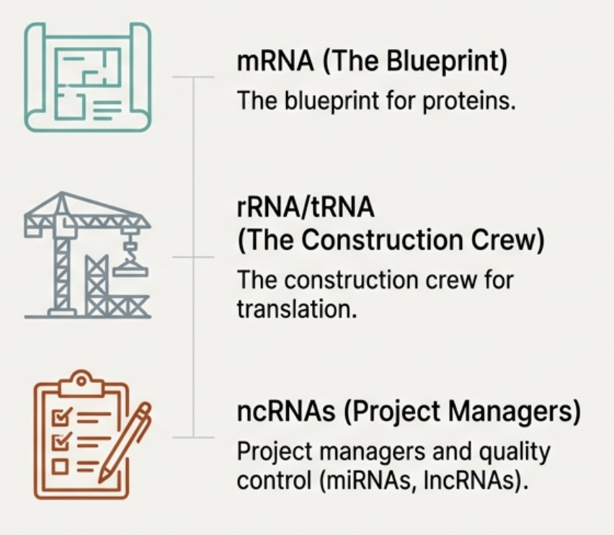
RNA TYPES
🧬 mRNA: codes for proteins
🔹 tRNA & rRNA: translation machinery
🌀 ncRNA: regulatory and structural roles

Slide 6
RNA EXPRESSION VS GENE ACTIVITY
📊 Expression is a proxy for gene activity
💡 Post-transcriptional regulation may decouple expression from function
🔍 Importance of experimental validation

Slide 7
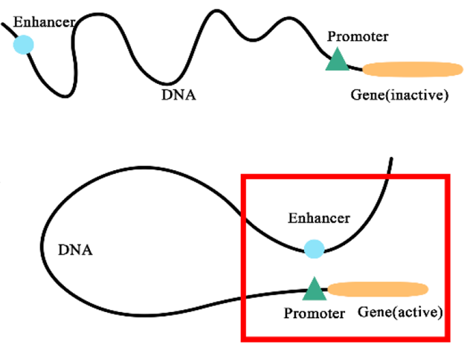
REGULATORY ELEMENTS
🏷️ Promoters initiate transcription
✨ Enhancers increase transcription efficiency
🔗 Interaction with transcription factors controls expression

Slide 8
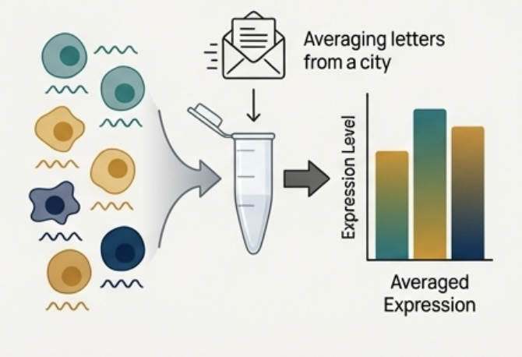
BULK RNA-SEQ OVERVIEW
📋 Measures average gene expression across many cells
💻 High-throughput sequencing of RNA converted to cDNA
📈 Useful for identifying differentially expressed genes

Slide 9
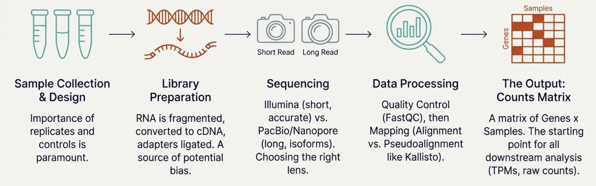
EXPERIMENTAL DESIGN ESSENTIALS
🧪 Replicates are critical for statistical power
⚖️ Control vs treatment comparison

Slide 10
LIBRARY PREPARATION CONCEPTS
🧬 RNA fragmentation and reverse transcription
🔗 Adapter ligation for sequencing
⚡ Amplification and indexing for multiplexing

Slide 11
SEQUENCING TECHNOLOGIES
💻 Illumina short-read sequencing is most common
📏 PacBio and Nanopore provide long-read options
🔍 Choice affects isoform resolution and error profiles

Slide 12
READ QUALITY ASSESSMENT
⚡ Evaluate base quality and GC content
🧹 Remove low-quality reads and adapters
📊 FastQC is commonly used for QC reports

Slide 13
ALIGNMENT VS PSEUDOALIGNMENT
🧩 Alignment maps reads to a reference genome
⚡ Pseudoalignment (e.g., Kallisto) is faster
💡 Trade-offs between speed and transcript resolution

Slide 14
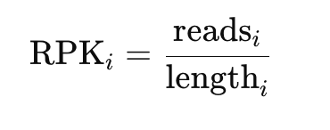
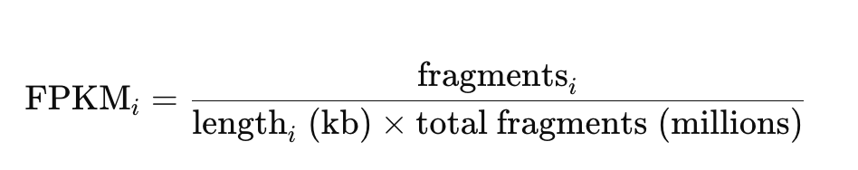
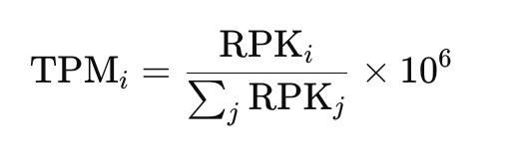
GENE AND TRANSCRIPT QUANTIFICATION
📊 Count reads per gene or transcript
⚖️ Normalize for library size and gene length
💡 Produces TPM, FPKM, or counts

Slide 15
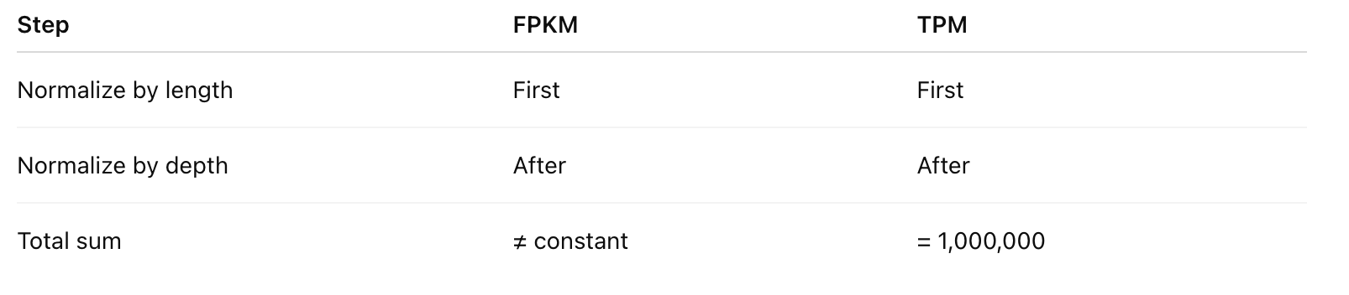
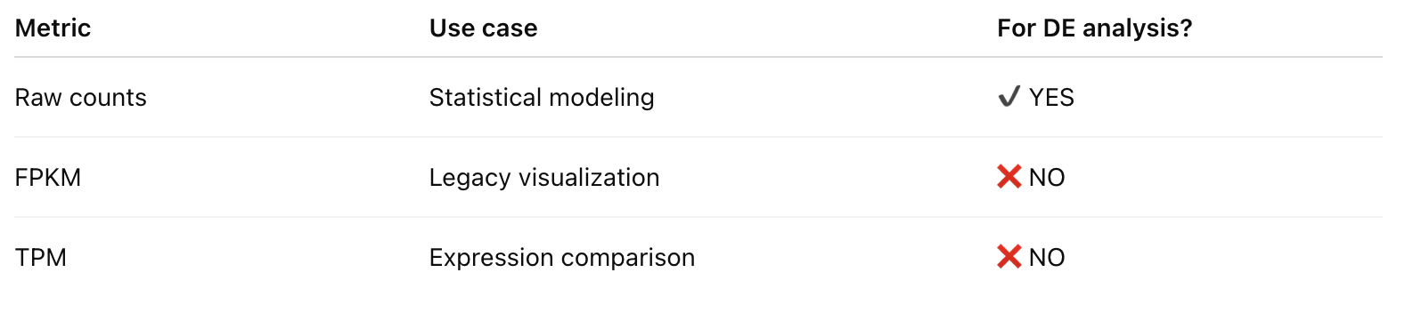
GENE AND TRANSCRIPT QUANTIFICATION

Slide 16


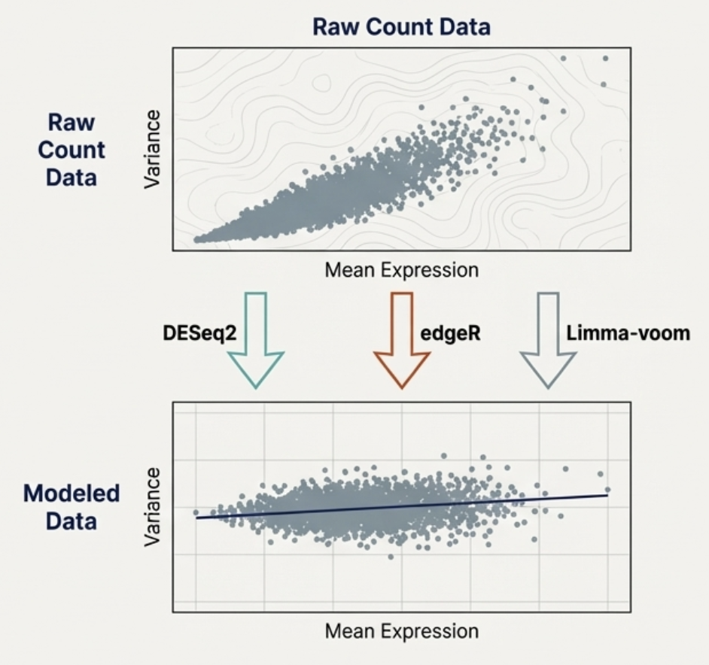
STATISTICAL FRAMEWORK FOR RNA-SEQ
📊 Count data follows discrete distributions
🧮 Proper statistics are essential for inference

Slide 17
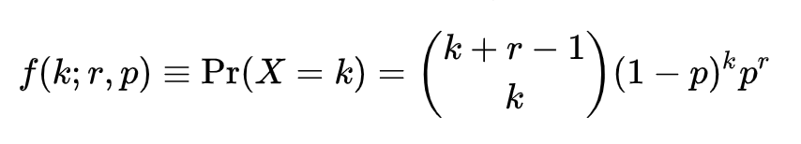
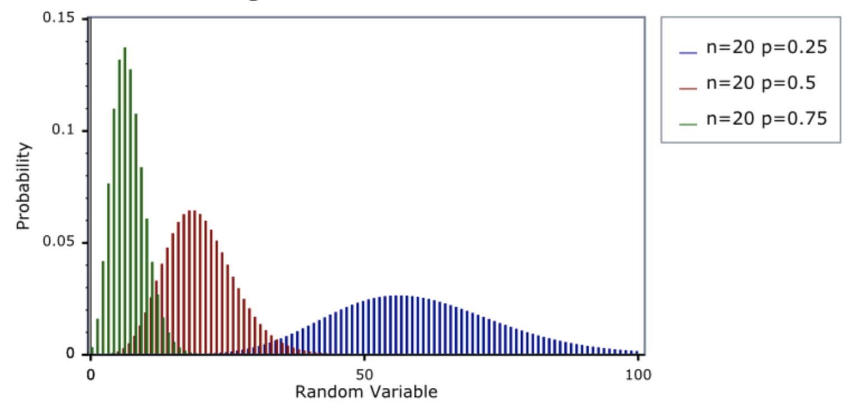
STATISTICAL FRAMEWORK FOR RNA-SEQ
⚖️ Negative binomial models capture biological variability

Slide 18
DESEQ2: NEGATIVE BINOMIAL MODELING
💻 Widely used tool for differential expression
📈 Fits negative binomial model with shrinkage estimation
🔍 Produces fold changes and adjusted p-values

Slide 19
EDGER: EMPIRICAL BAYES & GLMS
📊 Another popular DE tool for RNA-seq
🧬 Uses empirical Bayes methods to stabilize variance estimates
⚖️ Handles complex experimental designs with GLMs

Slide 20
LIMMA-VOOM: MEAN-VARIANCE
🧮 Converts counts to log2-counts per million
📊 Estimates mean-variance trend for linear modeling
⚡ Useful for large datasets and batch correction

Slide 21
BATCH EFFECT CHALLENGES
⚠️ Technical variability may confound results
📊 Uncorrected batch effects reduce statistical power
💡 Identify sources using PCA or clustering

Slide 22
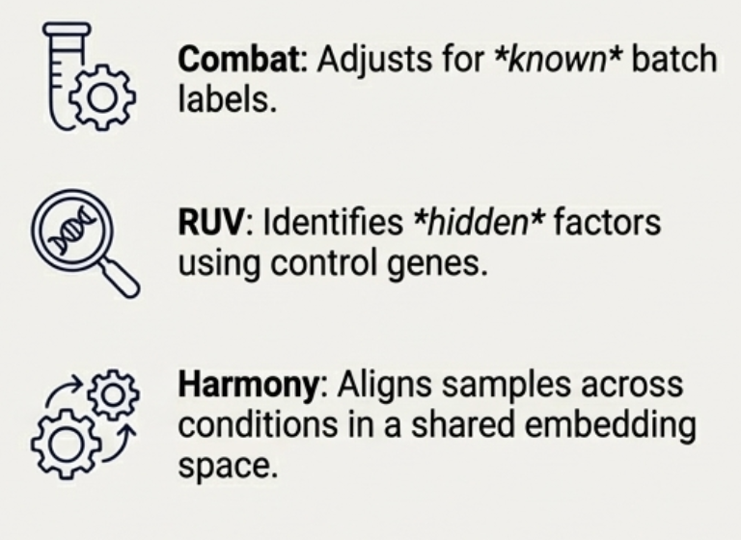
BATCH EFFECTS: COMBAT, RUV, HARMONY
🔄 Combat uses empirical Bayes framework
🧩 RUV and Harmony remove unwanted variation in multi-batch data

Slide 23
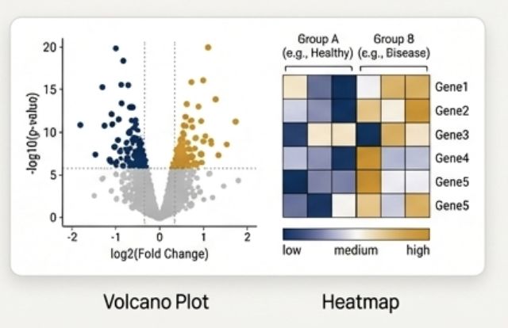
VISUALIZATIONS
📊 Volcano plots highlight fold-change vs significance
🌡️ MA-plots show expression vs log-fold change

Slide 24
CLUSTERING & HEATMAPS
🖥️ Visualize expression patterns across samples
🔍 Identify co-expressed gene modules
🎨 Hierarchical or k-means clustering methods used

Slide 25
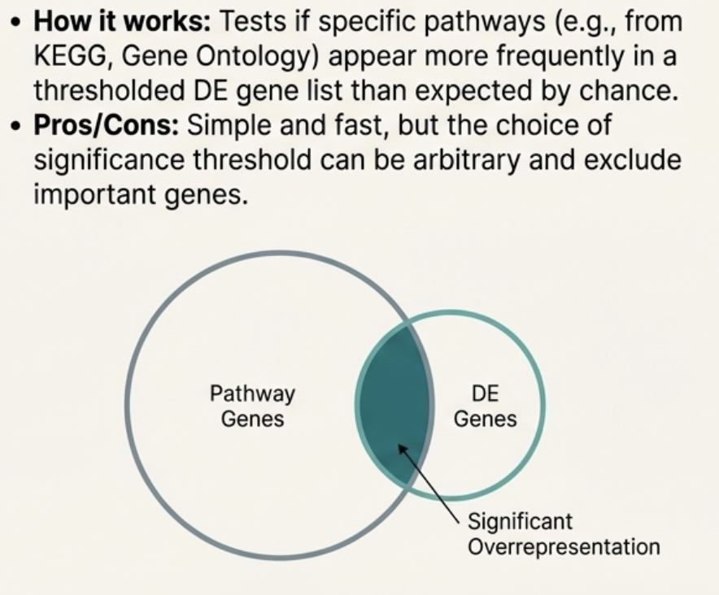
OVERREPRESENTATION ANALYSIS (ORA)
🔹 Tests if a set of genes is enriched in a pathway
📊 Hypergeometric or Fisher exact tests
💡 Provides functional context for DE genes

Slide 26
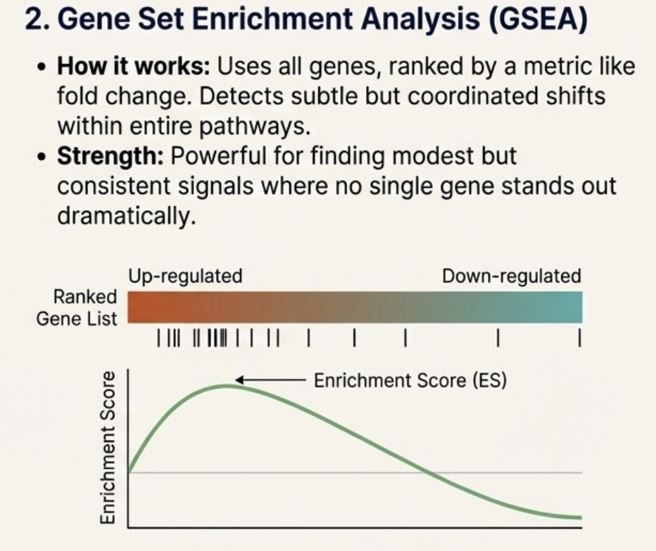
GENE SET ENRICHMENT ANALYSIS (GSEA)
📈 Considers ranked gene lists, not just DE cutoff
🧬 Detects subtle, coordinated expression changes

Slide 27
PATHWAY DATABASES OVERVIEW
🌐 KEGG: metabolic and signaling pathways
📚 Reactome: curated human pathways
🧬 Gene Ontology (GO) for functional categories

Slide 28
RNA-SEQ DERIVED BIOMARKERS
💡 Use DE genes or modules as disease biomarkers
📊 Combine with clinical data for prediction
🧬 Requires validation in independent cohorts

Slide 29

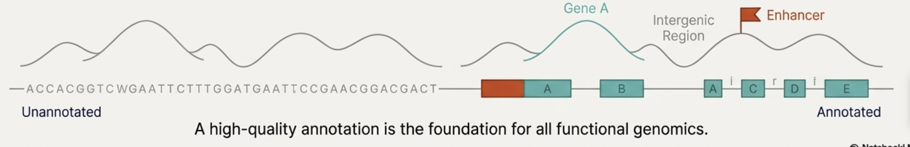
WHAT IS GENOME ANNOTATION?
🧩 Process of identifying genes and functional elements in a genome
🔍 Combines computational predictions and experimental evidence

Slide 30
STRUCTURAL VS FUNCTIONAL ANNOTATION
🏗️ Structural: genes, exons, introns, UTRs
⚡ Functional: protein domains, motifs, regulatory elements
🔗 Both required for a complete genome map

Slide 31
AB INITIO GENE PREDICTION
🧮 Uses statistical models to predict genes
📊 Tools: AUGUSTUS, GeneMark, GENSCAN
💡 Works best on well-characterized genomes
Notes:
Ab initio gene prediction methods attempt to identify genes using only the
genomic sequence and probabilistic models of gene structure. Tools like AU-
GUSTUS and GeneMark learn patterns such as codon bias, splice sites, intron
lengths, and start/stop codons. They then scan the genome for regions that
resemble typical gene architecture. This is similar to teaching a computer what
sentences look like, then asking it to nd sentences in a book written with-
out punctuation. Ab initio methods are fast and powerful but prone to false
positives, especially in complex genomes.

Slide 32
EVIDENCE-BASED METHODS
🧬 Incorporates RNA-seq, Iso-seq, EST alignments
🔗 Supports ab initio predictions with experimental data
💡 Improves accuracy of exon-intron boundaries
Notes:
In contrast, evidence-based annotation incorporates experimental data. RNA-
seq reads identify expressed exons and splice junctions, while long-read Iso-
seq reveals full-length transcripts and isoforms. These methods provide direct
evidence of transcription and improve accuracy dramatically. Instead of guessing
where genes might be, we watch the genome being transcribed in real time. Yet
even here, challenges remain: lowly expressed genes may be missed, and certain
tissues or developmental stages may not be sampled.

Slide 33
FUNCTIONAL ANNOTATION TOOLS
📚 InterPro, Pfam: protein domains and families
🧬 UniProt: curated protein function
💻 Predict molecular function, biological process, cellular component
Notes:
Functional annotation links predicted genes to their biological roles. Tools like
InterPro and Pfam scan protein sequences for conserved domains | motifs that
often determine protein function. UniProt provides curated descriptions, pro-
tein families, subcellular localizations, and functional annotations. You can
think of functional annotation as identifying the \profession" of each predicted
gene: kinase, transporter, transcription factor, or something entirely novel.
These annotations form the foundation for pathway analysis and evolutionary
comparisons.

Slide 34
TRANSCRIPTION FACTOR BINDING SITE
🔍 Identify potential regulatory sites
🏷️ Use motifs and position weight matrices
💡 Predict TF–gene regulatory interactions
Notes:
Beyond protein-coding genes, annotation also identi es regulatory sequences.
Transcription factor binding sites (TFBS) are short DNA motifs recognized by
transcription factors. Tools like FIMO, MEME, and JASPAR motif databases
predict where these sites occur. Because regulatory motifs are short and degen-
erate, prediction is challenging | like searching for a three-word phrase in a
massive book where many similar phrases exist. Nonetheless, TFBS prediction
helps reveal gene regulatory networks and transcriptional programs.

Slide 35
ENHANCER/PROMOTER PREDICTION
✨ Identify cis-regulatory elements
📊 Machine learning models improve prediction
🔗 Often integrated with ChIP-seq and ATAC-seq data
Notes:
Promoters and enhancers shape gene expression patterns, but unlike protein-
coding genes, they lack clear structural signatures. Predicting them relies on
chromatin marks (such as H3K4me3 for promoters or H3K27ac for enhancers),
DNA accessibility (ATAC-seq), and machine learning models. Algorithms such
as EP300-based peak calling, ChromHMM state modeling, and deep learning
tools like Basenji and DeepSEA use combinations of sequence and epigenomic
data. These models learn regulatory grammar | the patterns of nucleotides
and chromatin features that de ne active elements.

Slide 36
ANNOTATION OF REPETITIVE ELEMENTS
🌀 RepeatMasker, Tandem Repeats Finder
📌 Identify transposable elements and simple repeats
⚠️ Important to mask repeats for downstream analyses
Notes:
A surprisingly large fraction of eukaryotic genomes consists of repetitive ele-
ments: LINEs, SINEs, LTR retrotransposons, and simple repeats. Annotating
these regions is crucial because they inuence gene regulation, genome sta-
bility, and evolution. Tools like RepeatMasker identify and classify repetitive
sequences. You might think of repeats as \echoes" in the genome | patterns
that reoccur in many locations. They can complicate assembly, mapping, and
analysis, so proper annotation is essential.

Slide 37
MACHINE LEARNING IN ANNOTATION
🤖 Predict genes and regulatory elements
📊 Deep learning improves splice site and enhancer prediction
💡 Tools: DeepGene, SpliceAI
Notes:
Machine learning increasingly enhances annotation accuracy. Deep neural net-
works predict genes, splice junctions, TSS sites, enhancers, and chromatin states
directly from DNA sequence. Models like Basenji, Enformer, and SpliceAI learn
complex dependencies impossible to capture with handcrafted rules. These mod-
els treat DNA as a language and learn its syntax from enormous datasets. In
many cases, machine learning achieves or surpasses human expert-level annota-
tion accuracy.

Slide 38
ANNOTATION PIPELINES
🧩 Combine multiple tools for complete annotation
💻 Examples: MAKER, Ensembl, RefSeq pipelines
🔗 Integrate ab initio, evidence-based, and functional annotation
Notes:
Finally, full annotation projects use integrated pipelines such as MAKER, En-
sembl's automated annotation system, and the NCBI RefSeq pipeline. These
combine ab initio predictions, evidence from RNA-seq and protein homology,
repeat masking, and functional annotation into coherent gene models. Pipelines
also enforce consistency across organisms and versions. Whenever you visit En-
sembl or RefSeq and browse genes, transcripts, and regulatory regions, you're
seeing the output of large, automated annotation workows that synthesize
computational and experimental data into a uni ed annotation.

Slide 39
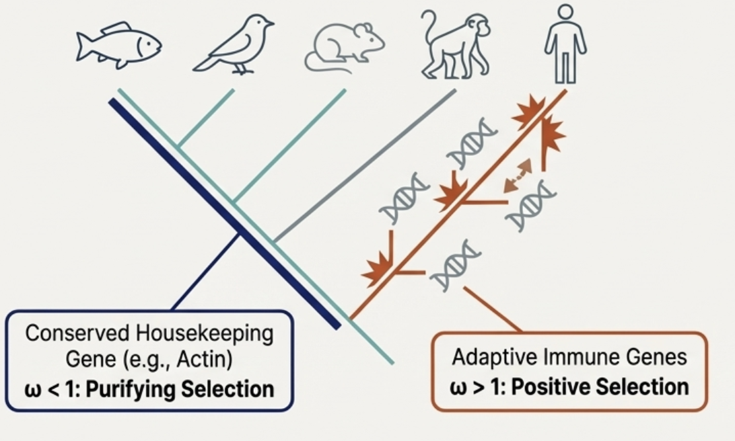

WHAT IS COMPARATIVE GENOMICS?
🔬 Compare genomes across species
🧬 Identify conserved and divergent regions
💡 Understand evolution and function of genes
Notes:
Comparative genomics is the study of similarities and di erences between genomes
across species, populations, or individuals. By aligning and contrasting genomes,
we uncover evolutionary relationships, conserved regulatory logic, and lineage-
speci c innovations. In essence, it is biology's version of comparative linguistics:
by comparing related \texts," we infer ancestral states, divergence events, and
functional constraints. Comparative genomics transforms raw sequences into
evolutionary narratives | telling us not only what genomes contain, but how
they came to be.

Slide 40
GENOME ALIGNMENT CHALLENGES
🧩 Large-scale sequence differences complicate alignment
⚖️ Balancing accuracy and computational efficiency
💻 Handling duplications, rearrangements, and gaps
Notes:
Aligning two genomes is already di cult, but aligning dozens or hundreds in-
troduces enormous computational and biological complexity. Genomes di er in
size, gene content, repeat structure, and evolutionary distance. Rearrangements,
duplications, and transpositions further obscure homology. Multiple genome
alignment requires algorithms capable of tracking orthologous regions through
evolutionary time. The challenge resembles aligning paragraphs between many
editions of a book | where entire chapters may have been rearranged, dupli-
cated, or deleted.

Slide 41
WHOLE-GENOME ALIGNMENT TOOLS
📊 Handles rearranged genomes
🧩 Identifies conserved blocks (Locally Collinear Blocks)
💡 Useful for bacterial and small eukaryotic genomes
Notes:
MAUVE pioneered scalable whole-genome alignment by identifying locally collinear
blocks (LCBs) | genomic segments shared across species with conserved or-
der. These blocks anchor alignments even in the presence of rearrangements.
MAUVE visualizes synteny, inversions, and breakpoints, making it especially
valuable for bacterial and small eukaryotic genomes. The software's approach
is analogous to matching shared phrases in manuscripts to determine which
passages correspond, even when chapter order di ers dramatically.

Slide 42
CACTUS & PROGRESSIVECACTUS
🌳 Graph-based alignment for multiple genomes
⚡ Scales to vertebrate and plant genomes
🔗 Captures complex rearrangements and duplications
Notes:
For large-scale projects | such as aligning hundreds of vertebrate genomes
| the eld turns to Cactus and ProgressiveCactus. These tools model evo-
lution through a hierarchical, phylogeny-aware pipeline that constructs align-
ments progressively from ancestral nodes. The result is a highly accurate mul-
tiple alignment that captures subtle evolutionary signals. Cactus treats genome
alignment like reconstructing a family tree of manuscripts, generating ances-
tral intermediates and aligning them iteratively. This approach underlies the
massive alignments used by the UCSC Genome Browser's comparative tracks.

Slide 43
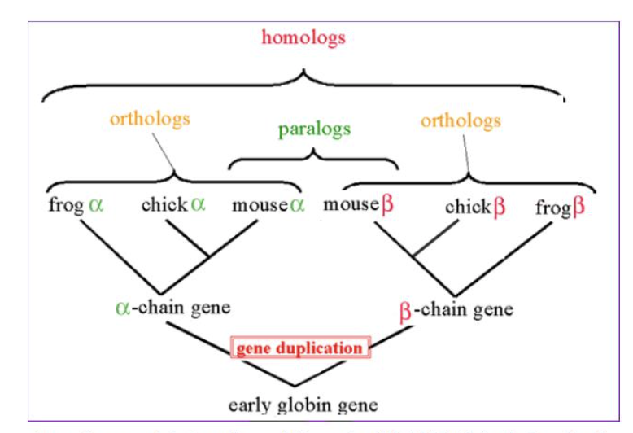
ORTHOLOG/PARALOG PREDICTION
🔹 Identify genes derived from common ancestors (orthologs)
🧬 Distinguish paralogs from gene duplication events
💻 Tools: OrthoFinder, EggNOG
Notes:
A central question in comparative genomics is distinguishing orthologs | genes
separated by speciation | from paralogs resulting from duplication. Tools like
EggNOG and OrthoFinder build gene families, infer duplication events, and map
orthology relationships. Identifying orthologs is crucial because they are most
likely to retain similar function across species, forming the basis for functional
transfer. Paralog analysis, on the other hand, reveals how gene families expand
and diversify, often leading to new biological capabilities.

Slide 44
GENE FAMILY EVOLUTION MODELS
📈 Model gain and loss of genes over evolutionary time
🧬 Detect expansions or contractions in gene families
💡 Insights into adaptation and specialization
Notes:
Gene families evolve through gains, losses, and duplications across lineages.
Models such as the birth{death process quantify these events and estimate rates
of expansion or contraction. These models help identify rapidly evolving families
|such as immune genes, olfactory receptors, or detoxi cation enzymes|which
often correlate with ecological adaptation. Gene family evolution is a genomic
ngerprint of selective pressures acting across millions of years.

Slide 45
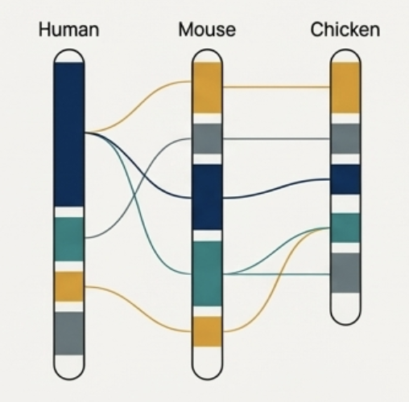
SYNTENY ANALYSIS
🔗 Identify conserved gene order across genomes
📊 Detect chromosomal rearrangements
💡 Useful for functional and evolutionary studies
Notes:
Synteny|the conserved ordering of genes on chromosomes|provides powerful
clues about evolutionary history. Syntenic blocks persist over long evolutionary
distances, while breaks in synteny signal rearrangements. Tools like MCScanX
or SynChro detect and visualize these relationships. Studying synteny is like
comparing city maps: the locations of neighborhoods stay similar across time,
even if streets rise, fall, or shift. When gene order is preserved, we infer ancestral
architectures; when disrupted, we detect evolutionary innovation.

Slide 46
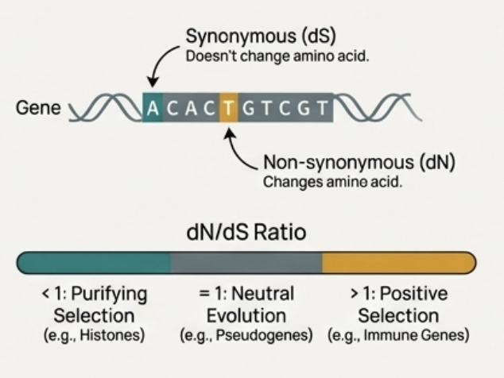
SELECTION TESTS: DN/DS, CODON MODELS
🧮 Measure nonsynonymous vs synonymous substitution rates
⚡ Identify genes under positive or purifying selection
💡 Tools: PAML, HyPhy
Notes:
One of the most direct ways to study molecular evolution is to compare non-
synonymous (dN) and synonymous (dS) substitution rates. The ratio dN/dS,
or !, measures selective pressure: values less than 1 indicate purifying selec-
tion, equal to 1 suggest neutrality, and greater than 1 imply positive selection.
Codon substitution models (implemented in PAML, HyPhy, and others) allow
ne-grained inference across lineages or sites. These models read the evolution-
ary \punctuation marks" hidden in coding sequences.

Slide 47
IDENTIFYING POSITIVE SELECTION
🔍 Detect adaptive evolution in coding sequences
📊 Compare multiple species or populations
💡 Focus on genes linked to environmental adaptation or disease resistance
Notes:
Detecting positive selection requires careful modeling to avoid false positives.
Methods include branch-site models, site-wise analyses, and likelihood ratio
tests. Integrating population-level variation (such as selective sweeps or high-
frequency derived alleles) further strengthens inference. Identifying positively
selected genes helps reveal traits under adaptive pressure | immune genes re-
sponding to pathogens, metabolic enzymes adapting to diet, or sensory systems
evolving to new environments.

Slide 48
PHYLOGENOMICS APPROACHES
🌳 Construct evolutionary trees using genome-scale data
🧬 Use concatenation or coalescent methods
💡 Resolve deep and shallow evolutionary relationships
Notes:
Phylogenomics integrates evolutionary tree-building with large-scale genomic
data. Rather than using a single gene, modern phylogenetics relies on thou-
sands of orthologous sequences, gene families, or even full alignments. Methods
include concatenated supermatrices, coalescent-based species trees, and gene-
tree reconciliation. Phylogenomics improves both evolutionary accuracy and
resolution, reconstructing the \tree of life" with unprecedented detail.

Slide 49
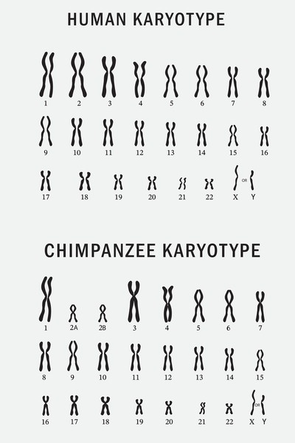
GENOME REARRANGEMENTS
🔄 Detect inversions, translocations, and duplications
🧩 Breakpoint graphs represent adjacency of genome segments
💡 Useful for understanding structural evolution
Notes:
Genomes evolve not only through point mutations but also through rearrange-
ments such as inversions, translocations, duplications, and ssions/fusions. Break-
point graphs model rearrangements mathematically, allowing computation of
minimal rearrangement scenarios. This framework treats genomes as permuta-
tions and evolution as a sequence of operations transforming one permutation
into another. The approach reveals dramatic evolutionary events | such as the
karyotype reshaping that distinguishes primates or birds.

Slide 50
COMPARATIVE PANGENOMICS
🧬 Combine multiple genomes into a pangenome graph
📊 Identify core and accessory genes
💡 Understand species-level variation and evolution
Notes:
Comparative pangenomics extends the idea of a pangenome | core and acces-
sory genomic content | across entire clades. Instead of comparing single ref-
erence genomes, we compare population-level variation across multiple species.
This highlights shared core gene sets, lineage-speci c innovations, and the dy-
namics of gene gain/loss. Comparative pangenomics is rede ning how we un-
derstand \a genome": not as a single linear sequence, but as a exible, evolving
cloud of genetic diversity across species and populations.

Slide 51

WHAT IS STRUCTURAL GENOMICS?
🧩 Studies large-scale genome structure and organization
🔬 Focuses on structural variants and genome architecture
💡 Complements functional and transcriptomic studies
Notes:
Structural genomics examines how the physical arrangement of DNA | its
large-scale architecture, structural variants, repetitive elements, and chromoso-
mal organization | shapes biological function. While earlier sections focused
largely on gene-level expression and annotation, structural genomics shifts our
attention to the \infrastructure" of the genome. Just as a city's layout in
ences how people move and interact, genomic architecture a ects replication,
recombination, regulation, and disease susceptibility. Understanding this archi-
tecture lets us see genomes as dynamic 3D structures, not merely linear strings
of bases.

Slide 52
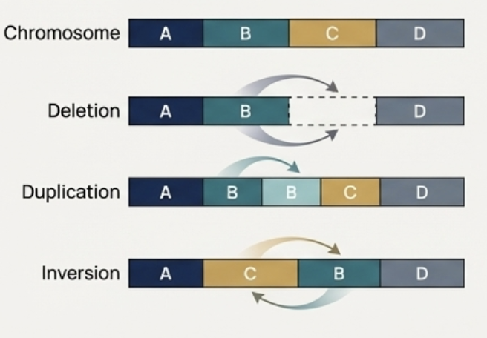
TYPES OF STRUCTURAL VARIANTS (SVS)
🔹 Deletions, duplications, inversions, translocations
🧬 Can impact gene function and regulation
⚠️ Important in evolution and disease
Notes:
Structural variants are genomic alterations larger than 50 bp, encompassing
deletions, duplications, inversions, insertions, and translocations. They can
disrupt genes, alter regulatory landscapes, or create novel fusion events. SVs
contribute more nucleotide alteration between human individuals than SNPs do,
revealing their crucial role in phenotypic diversity. Many SVs occur in repetitive
regions, making them di cult to detect with short reads. Conceptually, SVs
are like architectural renovations: removing walls, adding extensions, or
entire rooms within the genomic \building."

Slide 53
COPY NUMBER VARIATION
📊 Identify gains and losses of genomic regions
💻 Tools: CNVnator, Control-FREEC
💡 Important for cancer and population genomics studies
Notes:
Copy number variants (CNVs) represent large-scale gains or losses of genomic
segments. Detecting CNVs from sequencing involves analyzing read depth, split
reads, and discordant read pairs. Tools for CNV analysis often integrate multiple
signals to improve accuracy. CNVs have profound implications, inuencing gene
dosage in development, immunity, cancer, and neurological conditions. From a
biological perspective, CNVs are dosage adjustments: turning gene \volume
knobs" up or down across populations and diseases.

Slide 54
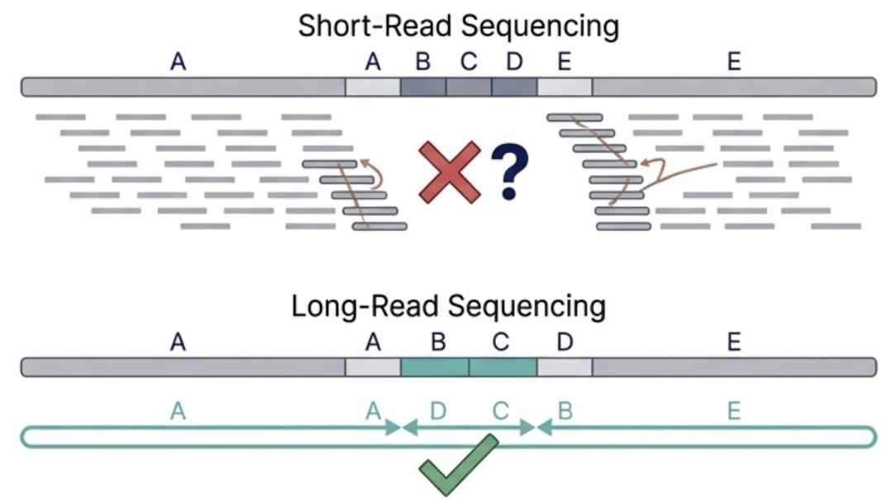
SV DETECTION IN LONG READS
Notes:
Long-read sequencing transformed structural genomics by spanning breaks, re-
peats, and complex rearrangements that short reads cannot resolve. Tools like
Sni es and SVIM analyze split-read alignments, coverage changes, and se-
quence features to detect SVs with high resolution. Long-read SV callers can
identify complex nested events, such as insertion{inversion combinations, which
were previously invisible. This shift is equivalent to replacing low-resolution
photographs of a landscape with high-de nition, panoramic images.

Slide 55
SV DETECTION IN LONG READS
⚡ Long reads improve detection of complex SVs
💻 Tools: Sniffles, SVIM
🧩 Captures large insertions and repetitive regions
Notes:
Long-read sequencing transformed structural genomics by spanning breaks, re-
peats, and complex rearrangements that short reads cannot resolve. Tools like
Sni es and SVIM analyze split-read alignments, coverage changes, and se-
quence features to detect SVs with high resolution. Long-read SV callers can
identify complex nested events, such as insertion{inversion combinations, which
were previously invisible. This shift is equivalent to replacing low-resolution
photographs of a landscape with high-de nition, panoramic images.

Slide 56
MOBILE GENETIC ELEMENTS
🌀 Transposons and retroelements reshape genomes
🔗 Can cause mutations or gene regulation changes
💡 Detection helps understand genome plasticity
Notes:
Mobile genetic elements|including LINEs, SINEs, retrotransposons, and DNA
transposons | constitute a major fraction of the human genome. Their move-
ment and proliferation have shaped genomic evolution over millions of years.
Some remain active today, inserting themselves into new locations and occasion-
ally causing disease. They behave somewhat like genomic \travelers," moving
between neighborhoods and rewriting the architectural plan. Mobile element
insertions challenge alignment, variant calling, and annotation, making them a
crucial component of structural genomics.

Slide 57
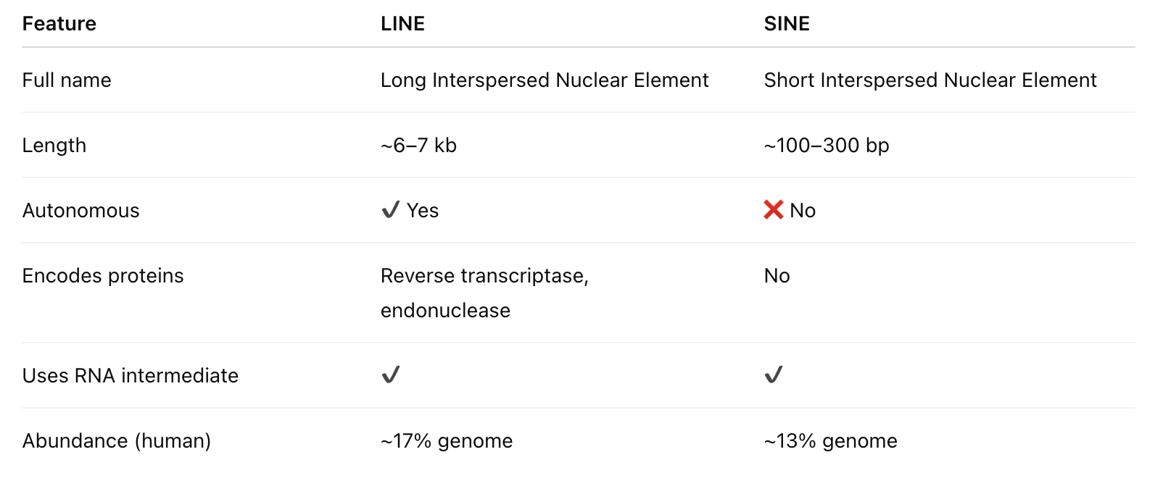
MOBILE GENETIC ELEMENTS
Notes:
Mobile genetic elements|including LINEs, SINEs, retrotransposons, and DNA
transposons | constitute a major fraction of the human genome. Their move-
ment and proliferation have shaped genomic evolution over millions of years.
Some remain active today, inserting themselves into new locations and occasion-
ally causing disease. They behave somewhat like genomic \travelers," moving
between neighborhoods and rewriting the architectural plan. Mobile element
insertions challenge alignment, variant calling, and annotation, making them a
crucial component of structural genomics.

Slide 58
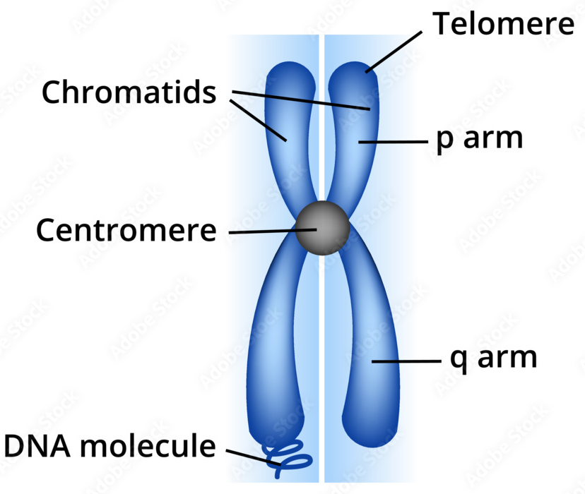
CENTROMERES AND TELOMERES
⚓ Centromeres: chromosome segregation
🔹 Telomeres: protect chromosome ends
🧬 Highly repetitive and challenging to sequence
Notes:
Centromeres and telomeres represent highly repetitive, specialized chromosomal
structures. Centromeres guide chromosome segregation through kinetochore for-
mation, while telomeres protect chromosome ends from degradation and fusion.
Their architecture is dominated by long arrays of repetitive sequences, making
them historically di cult to assemble. Recent advances in ultra-long reads and
HiFi sequencing have nally resolved centromeric and telomeric regions across
many species. These structures act as the \structural beams" of chromosomes,
maintaining stability during cell division and aging.

Slide 59
SEGMENTAL DUPLICATIONS AND DISEASE
🔄 Large duplicated regions can create instability
⚠️ Associated with developmental disorders
💡 Detected using long reads and assembly comparisons
Notes:
Segmental duplications (SDs) are large, nearly identical copies of genomic seg-
ments sprinkled across the genome. Their high sequence similarity predisposes
them to unequal crossing-over, leading to recurrent CNVs associated with disor-
ders such as DiGeorge syndrome or Williams syndrome. SDs also facilitate gene
family expansion and contribute to human-speci c traits. Studying SDs is like
examining repeated architectural motifs that simultaneously enable creativity
and vulnerability in genome structure.

Slide 60
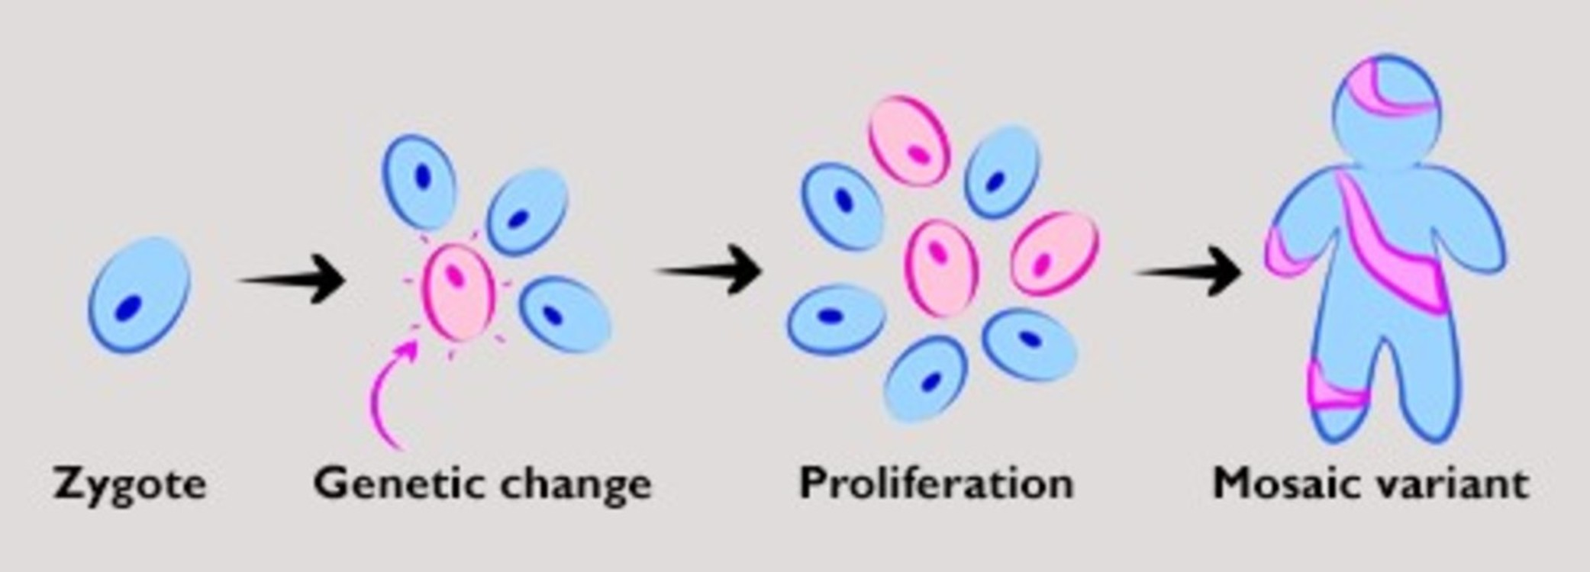
SOMATIC MOSAICISM
🧬 Genomic differences within an individual
⚡ Can occur during development or in cancer
Notes:
Somatic mosaicism refers to the presence of multiple genomic variants within
di erent cells of the same individual. Structural variants, CNVs, and mobile
element insertions can all arise during development or aging. This cellular het-
erogeneity plays an important role in neurodevelopment, immune diversity, and
cancer evolution. Mosaicism emphasizes that genomes are not xed blueprints;
they are dynamic documents that evolve within an organism's lifetime.

Slide 61
GENOMIC INSTABILITY HOTSPOTS
⚠️ Regions prone to rearrangements
🧩 Often enriched for repeats or fragile sites
💡 Relevant for evolution and disease studies
Notes:
Some genomic regions are more prone to breaks, rearrangements, and mutations.
These hotspots often overlap with fragile sites, replication timing boundaries,
repetitive elements, and regions with high transcriptional activity. Genomic
instability drives evolution but also underlies many diseases, particularly cancer.
Studying these hotspots reveals the stress points of the genome | the places
where mechanical and regulatory forces collide.

Slide 62
STRUCTURAL GENOMICS DATABASES
🌐 DGV: Database of Genomic Variants
🧩 dbVar: curated structural variants
💻 Provides reference for SV annotation and comparison
Notes:
A growing ecosystem of databases catalogs structural variants and architec-
tural features. Resources such as the Database of Genomic Variants (DGV),
gnomAD-SV, the Human Pangenome Reference, and UCSC's structural annota-
tion tracks provide reference maps of SVs across populations. Other databases
curate mobile elements, centromeric/telomeric annotations, or segmental du-
plications. These repositories enable researchers to contextualize new variants,
compare across populations, and integrate structural information into functional
and clinical studies.

Slide 63

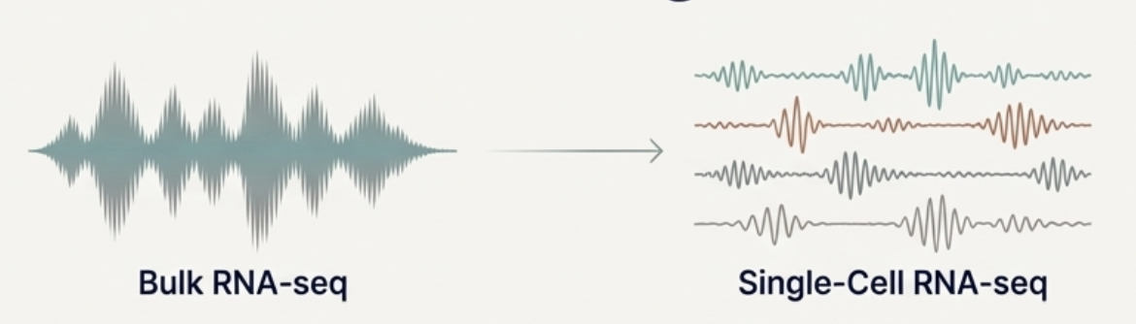
WHY SINGLE-CELL TRANSCRIPTOMICS?
🧬 Measure gene expression in individual cells
💡 Capture cellular heterogeneity hidden in bulk RNA-seq
Notes:
Traditional bulk RNA-seq provides an averaged view of gene expression across
many cells. However, tissues are heterogeneous: di erent cell types, states, or
rare populations can be masked in bulk measurements. Single-cell transcrip-
tomics allows us to capture this cellular diversity, uncovering rare cell types,
dynamic responses, and stochastic gene expression. Imagine listening to a choir:
bulk RNA-seq hears the chorus as a single sound, whereas single-cell methods
let you isolate each singer's voice.

Slide 64
SCRNA-SEQ EXPERIMENTAL OVERVIEW
🧪 Isolate single cells
🔄 Convert RNA to cDNA and amplify
💻 Sequence libraries to obtain transcriptomes
Notes:
Single-cell RNA-seq begins by isolating individual cells, reverse-transcribing
RNA into cDNA, amplifying, and sequencing each cell's transcriptome. The
resulting data is a matrix of genes versus cells, with counts representing RNA
abundance. Experimental challenges include low input material, technical noise,
and ampli cation bias. Despite these hurdles, the approach provides unprece-
dented resolution of cellular heterogeneity.

Slide 65
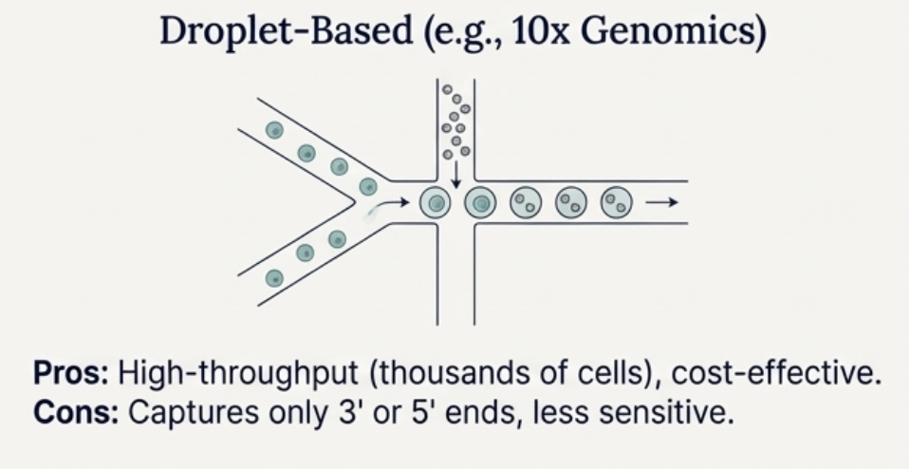
DROPLET-BASED scRNA-SEQ
📦 Encapsulate cells in microfluidic droplets
💡 High-throughput profiling of thousands of cells
⚡ Unique molecular identifiers (UMIs) reduce PCR bias
Notes:
Droplet-based methods, exempli ed by 10Å~ Genomics, encapsulate individual
cells in microdroplets containing barcoded beads. Each bead carries unique
molecular identi ers (UMIs) to label transcripts from a single cell. This ap-
proach allows pro ling of thousands to hundreds of thousands of cells in a single
experiment. It is high-throughput, cost-e cient, and widely used for large-scale
atlases, but it captures mainly 3' or 5' transcript ends, limiting full-length iso-
form analysis.

Slide 66
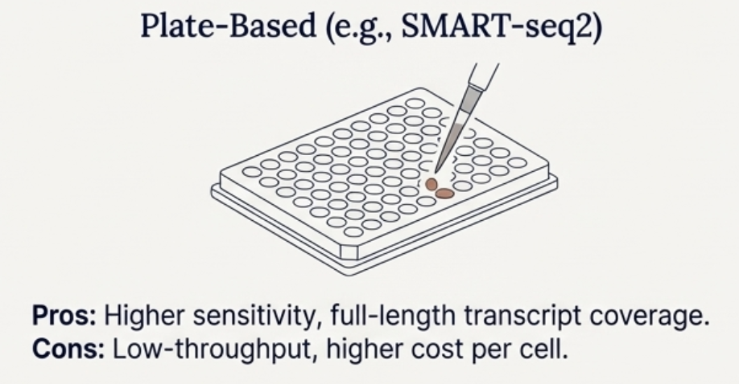
PLATE-BASED SCRNA-SEQ
📝 Full-length transcript coverage
💻 Higher sensitivity per cell
⚖️ Lower throughput than droplet-based methods
Notes:
Plate-based methods, like SMART-seq2, isolate individual cells into wells and
perform full-length cDNA ampli cation. They provide higher sensitivity and
coverage, capturing lowly expressed genes and isoforms. However, throughput
is limited, and costs per cell are higher. This method is ideal for in-depth studies
of a smaller number of cells or rare populations where transcript completeness
is essential.

Slide 67
CHARACTERISTICS: SPARSITY & DROPOUT
⚠️ Many zero counts due to low mRNA capture
📊 Leads to sparse matrices
💡 Requires specialized normalization and imputation methods
Notes:
Single-cell data is sparse: many genes appear to have zero counts in a given cell.
This dropout phenomenon arises from technical limitations, low RNA content,
and stochastic expression. Analysts must distinguish true biological zeros from
technical dropouts. Sparse data necessitates specialized normalization, imputa-
tion, and dimensionality reduction approaches. In e ect, scRNA-seq provides a
noisy but incredibly informative snapshot of each cell's transcriptional state.

Slide 68
PREPROCESSING & NORMALIZATION
🧹 Remove low-quality cells and genes
⚖️ Normalize for sequencing depth
💡 Optional log-transformation or scaling
Notes:
Preprocessing includes ltering low-quality cells, removing doublets, and nor-
malizing gene counts to correct for library size di erences. Common approaches
include CPM (counts per million), log-normalization, and size-factor adjust-
ment. Normalization ensures that downstream analyses reect biological varia-
tion rather than technical noise, making comparisons between cells meaningful.

Slide 69
CLUSTERING IN SCRNA-SEQ
🧩 Group cells with similar expression profiles
📊 Algorithms: Louvain, Leiden, k-means
💡 Identify putative cell types or states
Notes:
Clustering algorithms partition cells into groups based on transcriptional simi-
larity. Common approaches include Louvain or Leiden community detection on
k-nearest neighbor graphs. Clusters correspond to putative cell types, states, or
functional subpopulations. Clustering is often iterative: markers are inspected,
clusters are re ned, and biological meaning is assigned.

Slide 70
DIFFERENTIAL EXPRESSION IN CELLS
📊 Identify genes distinguishing clusters
⚖️ Use models accounting for zero inflation
💡 Tools: MAST, DESeq2 adaptations for scRNA-seq
Notes:
Di erential expression analysis compares gene expression between clusters or
conditions. Tools like MAST, edgeR, or DESeq2 adapted for single-cell data
account for sparsity and overdispersion. DE analysis identi es marker genes
that distinguish cell types or reveal responses to stimuli. Unlike bulk RNA-
seq, single-cell DE must consider variability across individual cells and dropout
e ects.

Slide 71
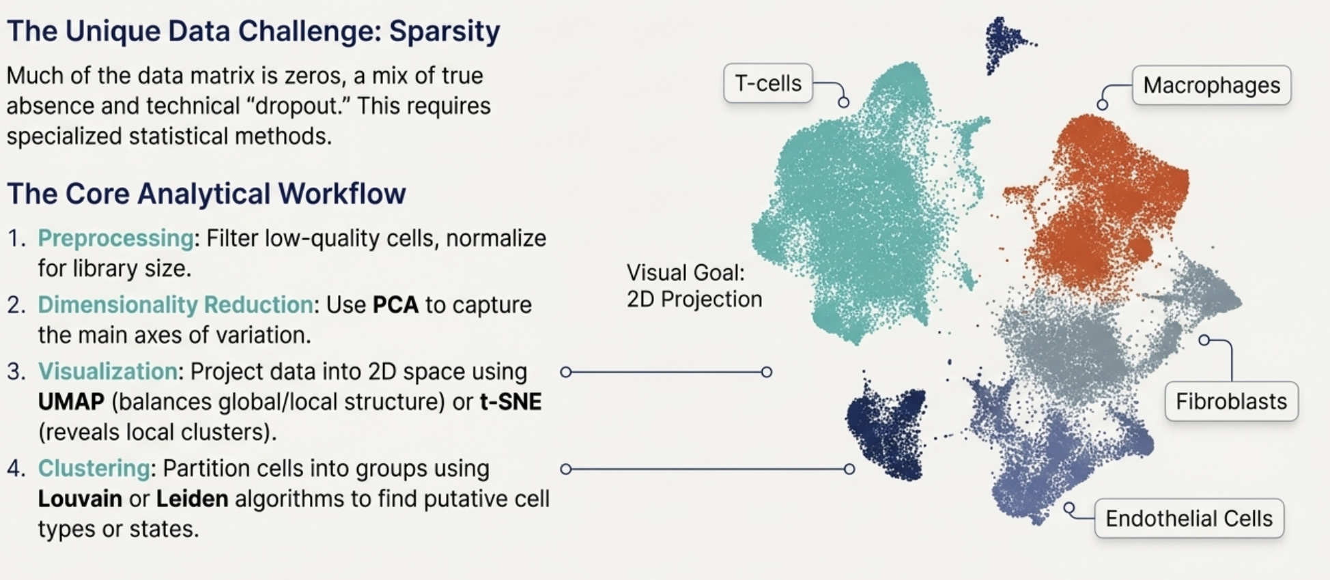
CELL TYPE IDENTIFICATION
🧬 Annotate clusters based on marker genes
💡 Reference atlases (e.g., Human Cell Atlas)
🔍 Cross-validation with known biology is crucial
Notes:
Once clusters are de ned, cell type identity is inferred using known marker genes,
reference atlases, or automated classi ers like SingleR or Garnett. Assigning
cell types translates abstract clusters into biologically interpretable populations,
enabling insights into tissue composition, developmental trajectories, or disease
mechanisms.

Slide 72
PSEUDOTIME & TRAJECTORIES
⏳ Reconstruct developmental or differentiation paths
📊 Order cells along a trajectory
💡 Tools: Monocle, Slingshot, Palantir
Notes:
Pseudotime analysis orders cells along a continuous trajectory reecting dy-
namic processes such as di erentiation, activation, or disease progression. Meth-
ods like Monocle and Slingshot infer trajectories from expression patterns. Pseu-
dotime transforms snapshots into inferred timelines, letting us reconstruct de-
velopmental or response processes from static data.

Slide 73
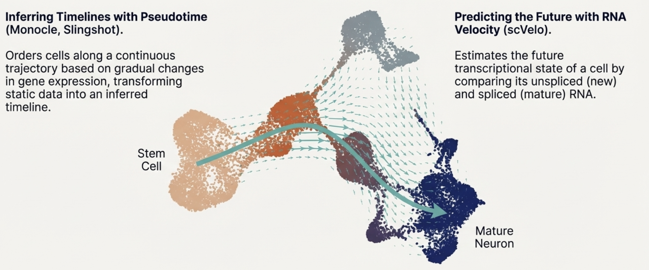
PSEUDOTIME & TRAJECTORIES

Slide 74
RNA VELOCITY OVERVIEW
⚡ Estimates future gene expression from spliced/unspliced ratios
🧩 Captures dynamic processes at single-cell level
💻 Tools: scVelo, velocyto
Notes:
RNA velocity extends pseudotime by estimating the future transcriptional state
of a cell based on ratios of spliced and unspliced RNA. Tools like scVelo provide
vector elds projected onto low-dimensional embeddings, predicting directional-
ity of cellular transitions. Velocity o ers a dynamic perspective, capturing how
cells are moving along di erentiation or activation paths.

Slide 75
INTEGRATION OF MULTIPLE DATASETS
🔗 Combine datasets from multiple samples or conditions
⚖️ Correct batch effects and technical variability
💡 Tools: Seurat, Harmony, LIGER
Notes:
Combining multiple single-cell datasets from di erent experiments, batches, or
conditions requires careful integration. Methods like Seurat v3/v4, Harmony,
or LIGER correct batch e ects while preserving biological variation. Integra-
tion enables cross-study comparisons, atlas construction, and meta-analyses of
cellular diversity.

Slide 76
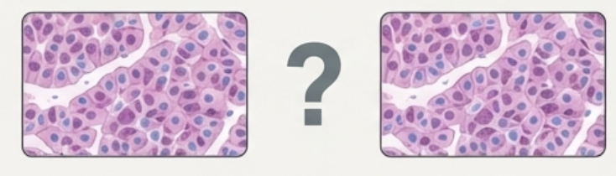
SPATIAL TRANSCRIPTOMICS BASICS
📍 Map gene expression to tissue locations
🧩 Combine histology and transcriptomics
💡 Emerging technologies: 10× Visium, Slide-seq, MERFISH
Notes:
Spatial transcriptomics combines single-cell RNA-seq with spatial information,
revealing gene expression patterns in tissue context. Methods include Slide-seq,
10Å~ Visium, and MERFISH. Spatial transcriptomics answers questions about
cellular neighborhoods, microenvironments, and tissue architecture, bridging
the gap between transcriptional state and physical location.

Slide 77
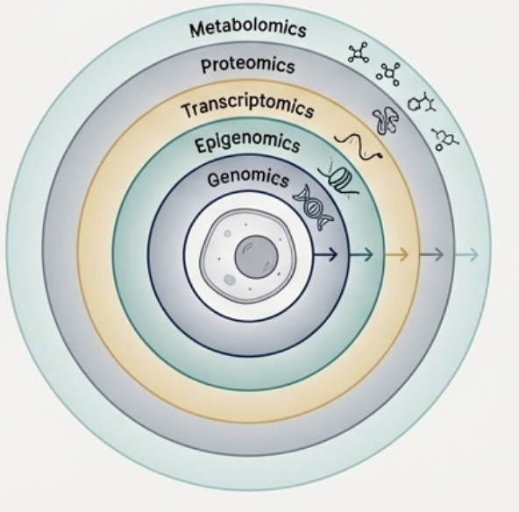

WHAT IS MULTI-OMICS?
🧬 Integration of genomics, transcriptomics, proteomics, and metabolomics
🔍 Reveals system-level insights not visible in single-omics
Notes:
Multi-omics refers to the integration of multiple layers of biological information
from the same samples or systems: genomics, transcriptomics, epigenomics,
proteomics, metabolomics, and beyond. Each omics layer provides a unique
perspective on cellular states and mechanisms. By combining these layers, we
gain a holistic view of biological systems, uncovering interactions invisible to
single-omics analyses. Think of multi-omics as looking at a city not just from
the street level, but from above, examining infrastructure, tra c, electricity,
and social patterns simultaneously.

Slide 78
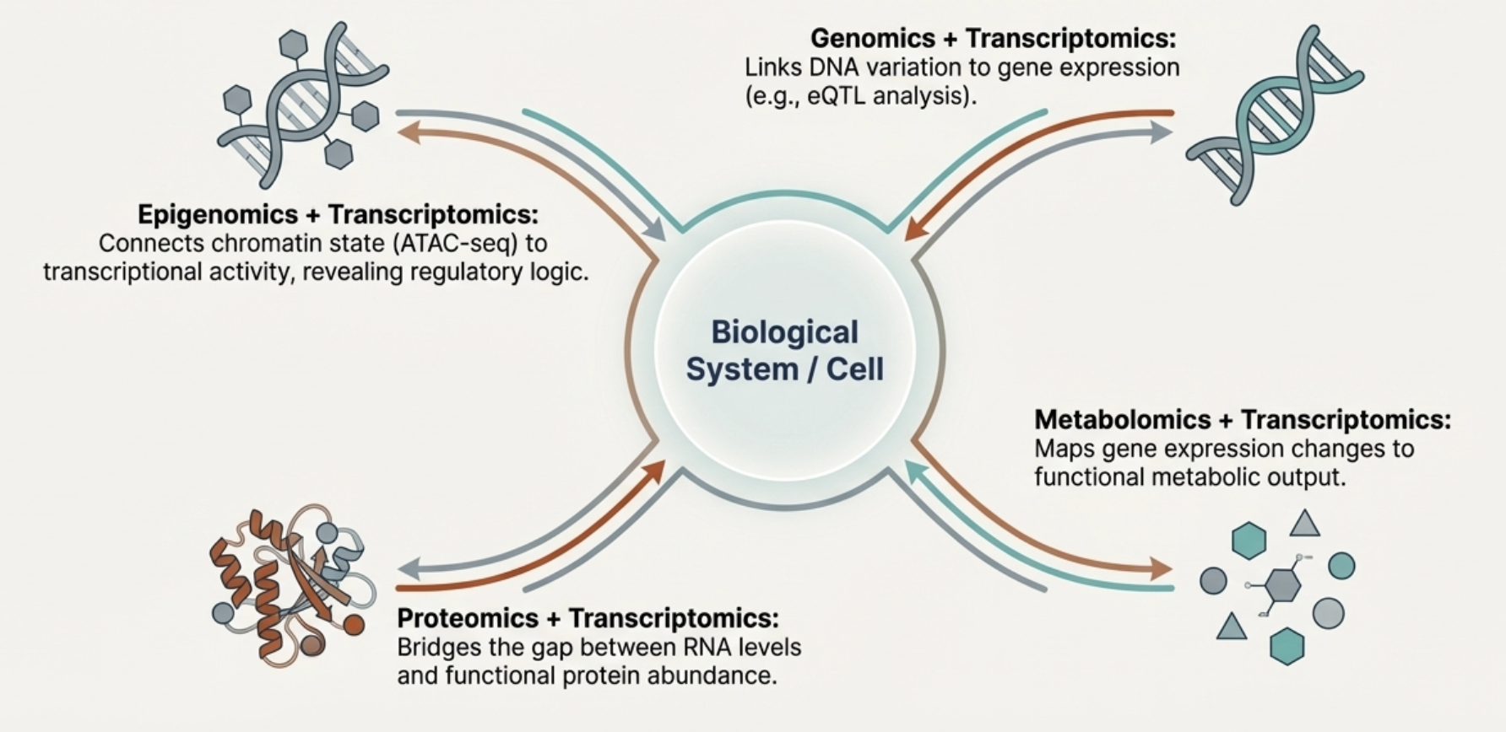
WHAT IS MULTI-OMICS?
Notes:
Multi-omics refers to the integration of multiple layers of biological information
from the same samples or systems: genomics, transcriptomics, epigenomics,
proteomics, metabolomics, and beyond. Each omics layer provides a unique
perspective on cellular states and mechanisms. By combining these layers, we
gain a holistic view of biological systems, uncovering interactions invisible to
single-omics analyses. Think of multi-omics as looking at a city not just from
the street level, but from above, examining infrastructure, tra c, electricity,
and social patterns simultaneously.

Slide 79
GENOMICS + TRANSCRIPTOMICS
🧬 Study how DNA variation affects RNA expression
⚡ eQTL mapping links variants to gene expression
💡 Identifies regulatory mechanisms
Notes:
Integrating genomic variants with transcriptomic pro les allows us to link DNA-
level variation to RNA expression. Expression quantitative trait loci (eQTL)
analysis is a key example: we identify which variants inuence gene expres-
sion. This integration helps uncover regulatory mechanisms, disease-associated
variants, and functional consequences of mutations.

Slide 80
EPIGENOMICS + TRANSCRIPTOMICS
🔒 DNA methylation, histone modifications, chromatin accessibility
📊 Correlate epigenetic marks with gene expression
💡 Reveals regulatory influence on transcription
Notes:
Epigenomic marks such as DNA methylation, histone modi cations, and chro-
matin accessibility inuence gene expression. Combining epigenomic and tran-
scriptomic data allows us to map regulatory logic: which enhancers or promoters
drive transcription in speci c contexts? Integration of ATAC-seq, ChIP-seq, or
bisul te sequencing with RNA-seq enables predictive models of transcriptional
regulation and identi cation of cell-type-speci c regulatory networks.

Slide 81
PROTEOMICS + TRANSCRIPTOMICS
🧬 Compare mRNA and protein abundance
⚡ Identify post-transcriptional regulation
💡 Understand protein-level phenotypic effects
Notes:
Proteins are the functional e ectors of cellular processes, but RNA levels do not
always perfectly predict protein abundance due to post-transcriptional regula-
tion. Integrating proteomics (e.g., mass spectrometry) with RNA-seq bridges
the gap between transcription and function. This layer reveals translational reg-
ulation, protein stability e ects, and post-translational modi cations, providing
a more complete view of cellular activity.

Slide 82
METABOLOMICS + TRANSCRIPTOMICS
⚗️ Link metabolic profiles to gene expression
🧬 Integrate pathways for system-level understanding
💡 Useful for disease and drug studies
Notes:
Metabolomics measures small molecules that reect cellular metabolic states.
Combining metabolite pro les with transcriptomics allows mapping of gene ex-
pression changes onto functional metabolic pathways. For instance, altered gly-
colytic gene expression can be linked to observed changes in metabolite levels,
connecting genotype, transcription, and phenotype in a uni ed framework.

Slide 83
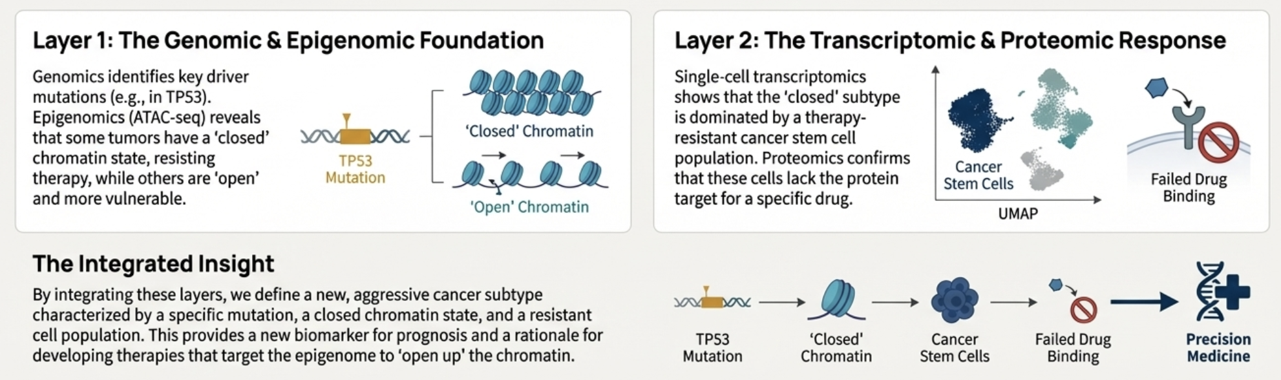
CASE STUDY
Notes:
Designing multi-omics experiments requires careful planning: selecting matched
samples, deciding which omics layers to measure, and determining sequencing
depth or measurement sensitivity. Integration is only meaningful when datasets
are comparable in quality and aligned in terms of experimental conditions.
Multi-omics is powerful but demands careful coordination to avoid confounding
and batch e ects across layers.

Slide 84
EXPERIMENTAL MULTI-OMICS DESIGNS
🧪 Decide which omics layers to measure
⚖️ Balance cost, throughput, and sample availability
💡 Time-course vs static measurements
Notes:
Designing multi-omics experiments requires careful planning: selecting matched
samples, deciding which omics layers to measure, and determining sequencing
depth or measurement sensitivity. Integration is only meaningful when datasets
are comparable in quality and aligned in terms of experimental conditions.
Multi-omics is powerful but demands careful coordination to avoid confounding
and batch e ects across layers.

Slide 85
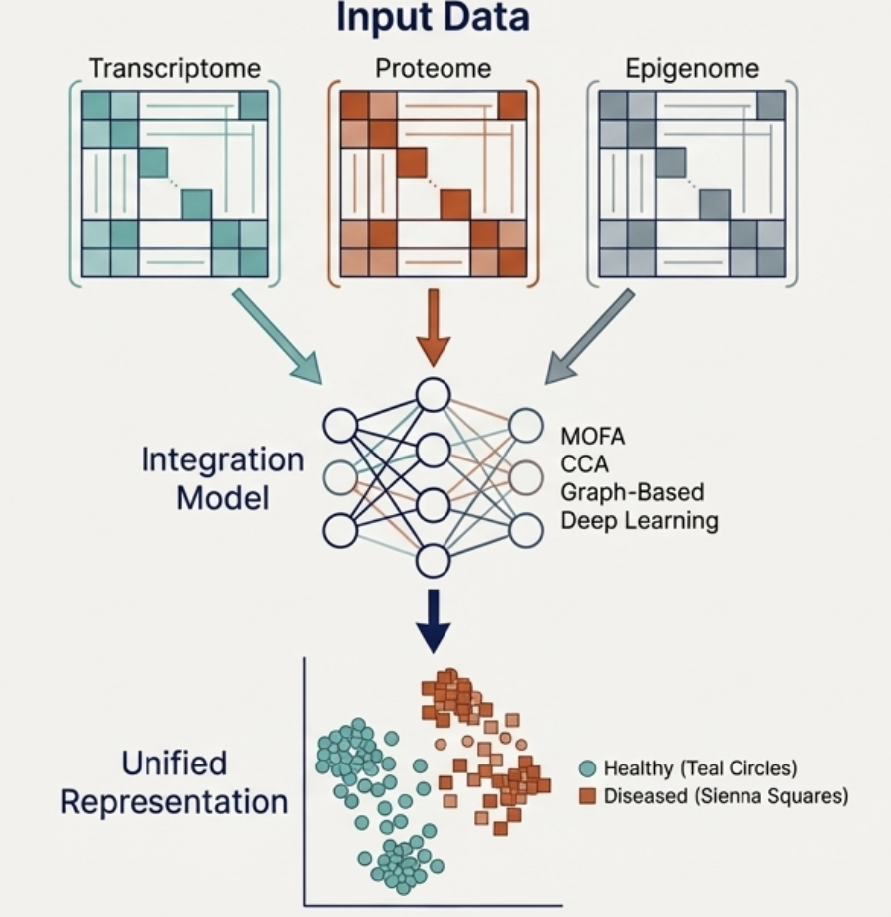
DIMENSIONALITY CHALLENGES
📊 Very high-dimensional data
⚖️ Risk of overfitting and noise propagation
💡 Requires specialized statistical or machine learning methods
Notes:
Multi-omics datasets are extremely high-dimensional: thousands of genes, pro-
teins, metabolites, and epigenomic features. Dimensionality presents challenges
for visualization, clustering, and statistical modeling. Naive concatenation of
datasets can overwhelm models and obscure signal. Dimensionality reduction
and feature selection are therefore critical for meaningful integration.

Slide 86
CANONICAL CORRELATION ANALYSIS (CCA)
🔗 Finds correlated patterns between two omics datasets
📊 Reduces dimensionality while preserving associations
💡 Useful for integrative exploratory analysis
Notes:
Canonical Correlation Analysis (CCA) is a classical method to nd correlated
patterns between two datasets, such as transcriptomics and proteomics. CCA
identi es pairs of linear combinations (maximally correlated canonical variates)
that reveal coordinated variation across layers. It is conceptually like nding
the hidden threads linking two stories: what patterns are shared between them
despite super cial di erences?

Slide 87
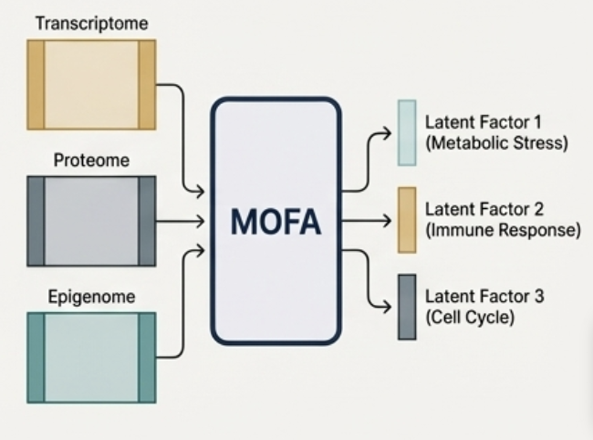
MOFA: MULTI-OMICS FACTOR ANALYSIS
📊 Latent factor model for multiple omics
🧬 Captures shared and dataset-specific variation
💡 Facilitates interpretation of complex systems
Notes:
MOFA is a probabilistic factor model that identi es latent factors explaining
variation across multiple omics layers. It captures shared and layer-speci c
patterns, allowing interpretation of underlying biological processes. MOFA is
particularly useful for heterogeneous datasets and provides a low-dimensional
embedding that can guide clustering, trajectory inference, or pathway analysis.

Slide 88
GRAPH-BASED INTEGRATION METHODS
🧩 Represent genes, proteins, and metabolites as nodes
🔗 Edges represent interactions or correlations
💡 Network algorithms reveal multi-layer connectivity
Notes:
Graph-based approaches model relationships between entities across omics lay-
ers. Nodes represent genes, proteins, metabolites, or epigenomic regions, and
edges encode known or predicted interactions. Integration leverages networks
to propagate information across layers, reveal modules, and detect multi-omics
signatures. These methods are particularly powerful for understanding complex
systems such as signaling cascades or metabolic networks.

Slide 89
DEEP LEARNING FOR MULTI-OMICS
🤖 Autoencoders, CNNs, GNNs for pattern discovery
⚡ Integrates heterogeneous data types
💡 Enables prediction of phenotypes from multi-omics
Notes:
Deep learning provides exible frameworks for multi-omics integration, captur-
ing nonlinear dependencies and complex patterns. Models such as variational
autoencoders, graph neural networks, and multi-modal CNNs learn shared rep-
resentations across layers. Deep learning approaches can predict outcomes, infer
hidden factors, and generate embeddings for downstream analysis, providing a
modern computational toolkit for multi-omics research.

Slide 90
MULTI-OMICS CASE STUDIES
💡 Cancer: integrate genome, transcriptome, proteome, metabolome
🧬 Development: track differentiation using scRNA-seq + epigenome
📊 Reveals novel biomarkers and mechanisms
Notes:
Finally, we examine practical applications. Multi-omics has been used to iden-
tify cancer subtypes, predict drug response, map developmental trajectories, and
uncover regulatory mechanisms in complex diseases. Integrative analyses reveal
insights that single-layer studies cannot: for instance, linking a genomic variant
to epigenetic changes, altered transcription, protein abundance, and metabolite
shifts | a complete chain from genotype to phenotype.

Slide 91

SUMMARY
🧬 Covered transcriptomics, annotation, evolutionary and structural genomics
🔗 Reviewed single-cell and multi-omics integration
💡 Key tools, methods, and databases highlighted

